Slide 1

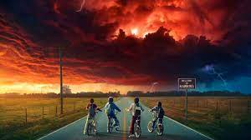

Slide 2
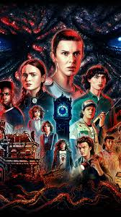
PROJECT OVERVIEW
This project, undertaken as a data challenge by Digits N Data, centered around the beloved TV series "Stranger Things." Spearheaded by Nitish Kumar, this initiative delves into database design, SQL querying, and data manipulation skills.
The objective of the Stranger Things database project is to meticulously organize and oversee all aspects related to this iconic series. Through a sophisticated relational database model, the project encompasses tables dedicated to characters, locations, events, relationships, and monsters. This framework offers a robust foundation for storing and effortlessly querying vital information.

Slide 3
TABLES USED
Relationships
Locations
Characters
Events
Monsters

Slide 4
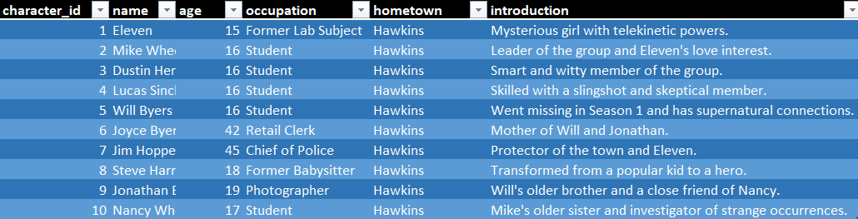
RETRIEVING THE DATA
Select * from Characters

Slide 5
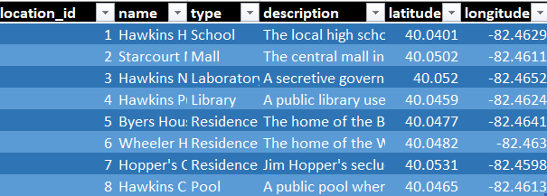
RETRIEVING THE DATA
Select * from Locations

Slide 6
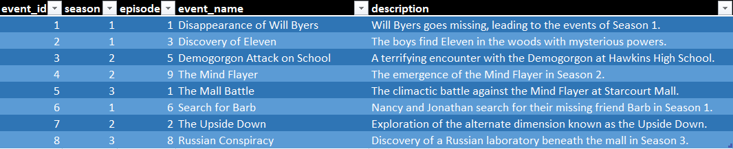
RETRIEVING THE DATA
Select * from Events

Slide 7
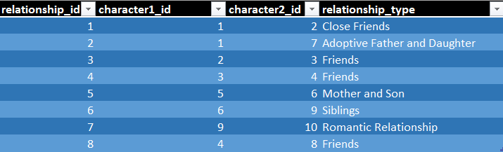
RETRIEVING THE DATA
Select * from Relationships

Slide 8
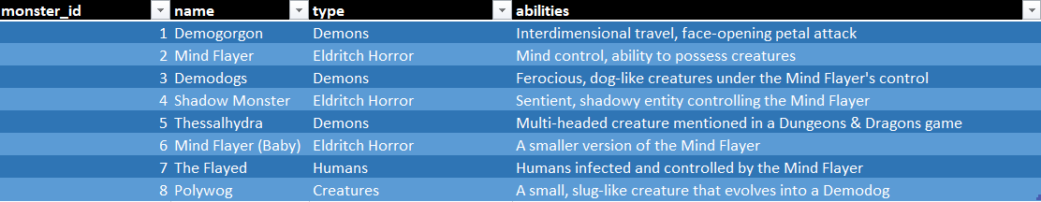
RETRIEVING THE DATA
Select * from Monsters

Slide 9
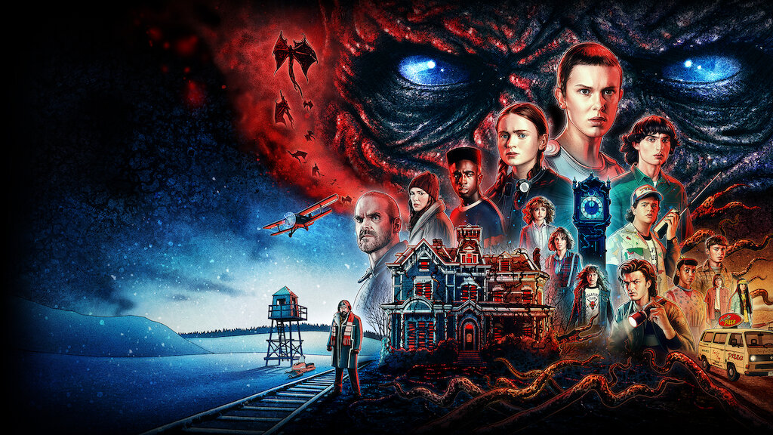
QUESTIONS
Retrieve The Names Of The Characters?
Select name from Characters;
name
Eleven
Mike Wheeler
Dustin Henderson
Lucas Sinclair
Will Byers
Joyce Byers
Jim Hopper
Steve Harrington
Jonathan Byers
Nancy Wheeler

Slide 10
QUESTIONS
JIM HOPPER
JONATHAN BYERS
JOYCE BYERS
Find The Characters With Age Greater Than 18?
Select name from characters where age>18;
name
Joyce Byers
Jim Hopper
Jonathan Byers

Slide 11
QUESTIONS
The Demogorgon, referred to as the Monster, was a humanoid predator that arrived in Hawkins, Indiana, in November 1983. It emerged from the parallel dimension called the Upside Down. When Eleven, a young test subject with psychokinetic powers from Hawkins National Laboratory, connected with the creature across dimensions, it opened a gateway between worlds at the lab. Subsequently, the creature entered Hawkins and began hunting, killing, and abducting local residents.
Find events in Season 2?
Select event_name from Events where season=2;
The Mind Flayer in Stranger Things is a sinister being from the Upside Down and acts as a primary antagonist throughout the series. It is a collective entity with a hive mind that has the ability to possess and manipulate individuals.
event_name
Demogorgon Attack on School
The Mind Flayer
The Upside Down
As the children seek answers, they uncover a sequence of remarkable mysteries, encounter psychokinetic abilities, and explore the Upside Down. Described in the show as an alternate realm mirroring our world, the Upside Down is an additional dimension accessible through a mystical portal.

Slide 12
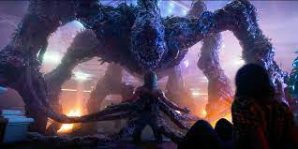
QUESTIONS
Get details of the 'Mind Flayer' monster ?
Select * from Monsters where name='Mind Flayer';
monster_id | name | type | abilities
2 | Mind Flayer | Eldritch Horror | Mind control, ability to possess creatures

Slide 13
QUESTIONS
character_name | event_name
Mike Wheeler | Disappearance of Will Byers
Eleven | Disappearance of Will Byers
Jim Hopper | Discovery of Eleven
Eleven | Discovery of Eleven
Dustin Henderson | Demogorgon Attack on School
Mike Wheeler | Demogorgon Attack on School
Lucas Sinclair | The Mind Flayer
Dustin Henderson | The Mind Flayer
Joyce Byers | The Mall Battle
Will Byers | The Mall Battle
Jonathan Byers | Search for Barb
Joyce Byers | Search for Barb
Nancy Wheeler | The Upside Down
Jonathan Byers | The Upside Down
Steve Harrington | Russian Conspiracy
Lucas Sinclair | Russian Conspiracy
Retrieve characters and their associated events?
Select c.name as character_name,e.event_name as event_name from characters c join relationships r on c.character_id=r.character1_id or c.character_id=r.character2_idjoin events eon e.event_id=r.relationship_id;

Slide 14
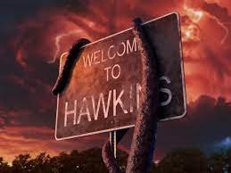
QUESTIONS
Calculate the total number of characters from each hometown ?
Select hometown,count(character_id) as cnt from characters group by hometown order by cnt desc;
All the 10 characters are from Hawkins

Slide 15
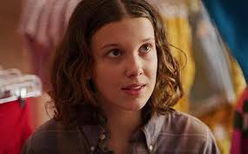
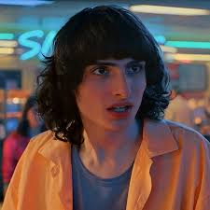
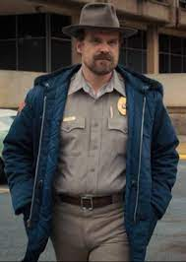
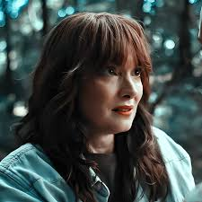
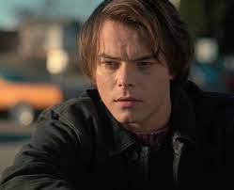
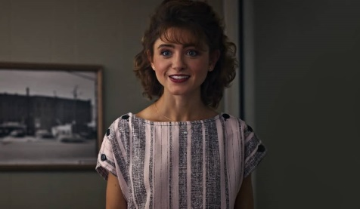
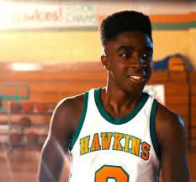
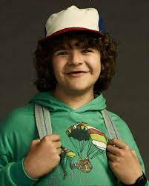
QUESTIONS
SEASON 1
Retrieve characters who were involved in events in Season 1 or Season 2?
Select c.name as character_name, e.season as season from characters c join relationships r on c.character_id=r.character1_id or c.character_id=r.character2_idjoin events e on e.event_id=r.relationship_id where e.season=1 or e.season=2;
Eleven
Mike Wheeler
Jim Hopper
Joyce Byers
Jonathan Byers
SEASON 2
character_name | season
Eleven | 1
Mike Wheeler | 1
Jim Hopper | 1
Joyce Byers | 1
Jonathan Byers | 1
Mike Wheeler | 2
Dustin Henderson | 2
Lucas Sinclair | 2
Jonathan Byers | 2
Nancy Wheeler | 2
Nancy Wheeler
Lucas Sinclair
Dustin Henderson
Mike Wheeler
Jonathan Byers

Slide 16
QUESTIONS
Jim Hopper
45
Jonathan Byers
19
Joyce Byers
42
Find the top 3 oldest characters?
Select * from characters order by age desc limit 3;
character_id | name | age | occupation | hometown | introduction
7 | Jim Hopper | 45 | Chief of Police | Hawkins | Protector of the town and Eleven.
6 | Joyce Byers | 42 | Retail Clerk | Hawkins | Mother of Will and Jonathan.
9 | Jonathan Byers | 19 | Photographer | Hawkins | Will's older brother and a close friend of Nancy.

Slide 17
QUESTIONS
Find the average age of characters in Hawkins?
Select round(avg(age)) from characters where hometown="Hawkins";
The average age of characters in Hawkins is 22 years

Slide 18
QUESTIONS
Rank characters by age in descending order?
Select *,rank() over(order by age desc) as rnk from characters;
character_id | name | age | occupation | hometown | introduction | rnk
7 | Jim Hopper | 45 | Chief of Police | Hawkins | Protector of the town and Eleven. | 1
6 | Joyce Byers | 42 | Retail Clerk | Hawkins | Mother of Will and Jonathan. | 2
9 | Jonathan Byers | 19 | Photographer | Hawkins | Will's older brother and a close friend of Nancy. | 3
8 | Steve Harrington | 18 | Former Babysitter | Hawkins | Transformed from a popular kid to a hero. | 4
10 | Nancy Wheeler | 17 | Student | Hawkins | Mike's older sister and investigator of strange occurrences. | 5
2 | Mike Wheeler | 16 | Student | Hawkins | Leader of the group and Eleven's love interest. | 6
3 | Dustin Henderson | 16 | Student | Hawkins | Smart and witty member of the group. | 6
4 | Lucas Sinclair | 16 | Student | Hawkins | Skilled with a slingshot and skeptical member. | 6
5 | Will Byers | 16 | Student | Hawkins | Went missing in Season 1 and has supernatural connections. | 6
1 | Eleven | 15 | Former Lab Subject | Hawkins | Mysterious girl with telekinetic powers. | 10

